Slide 1
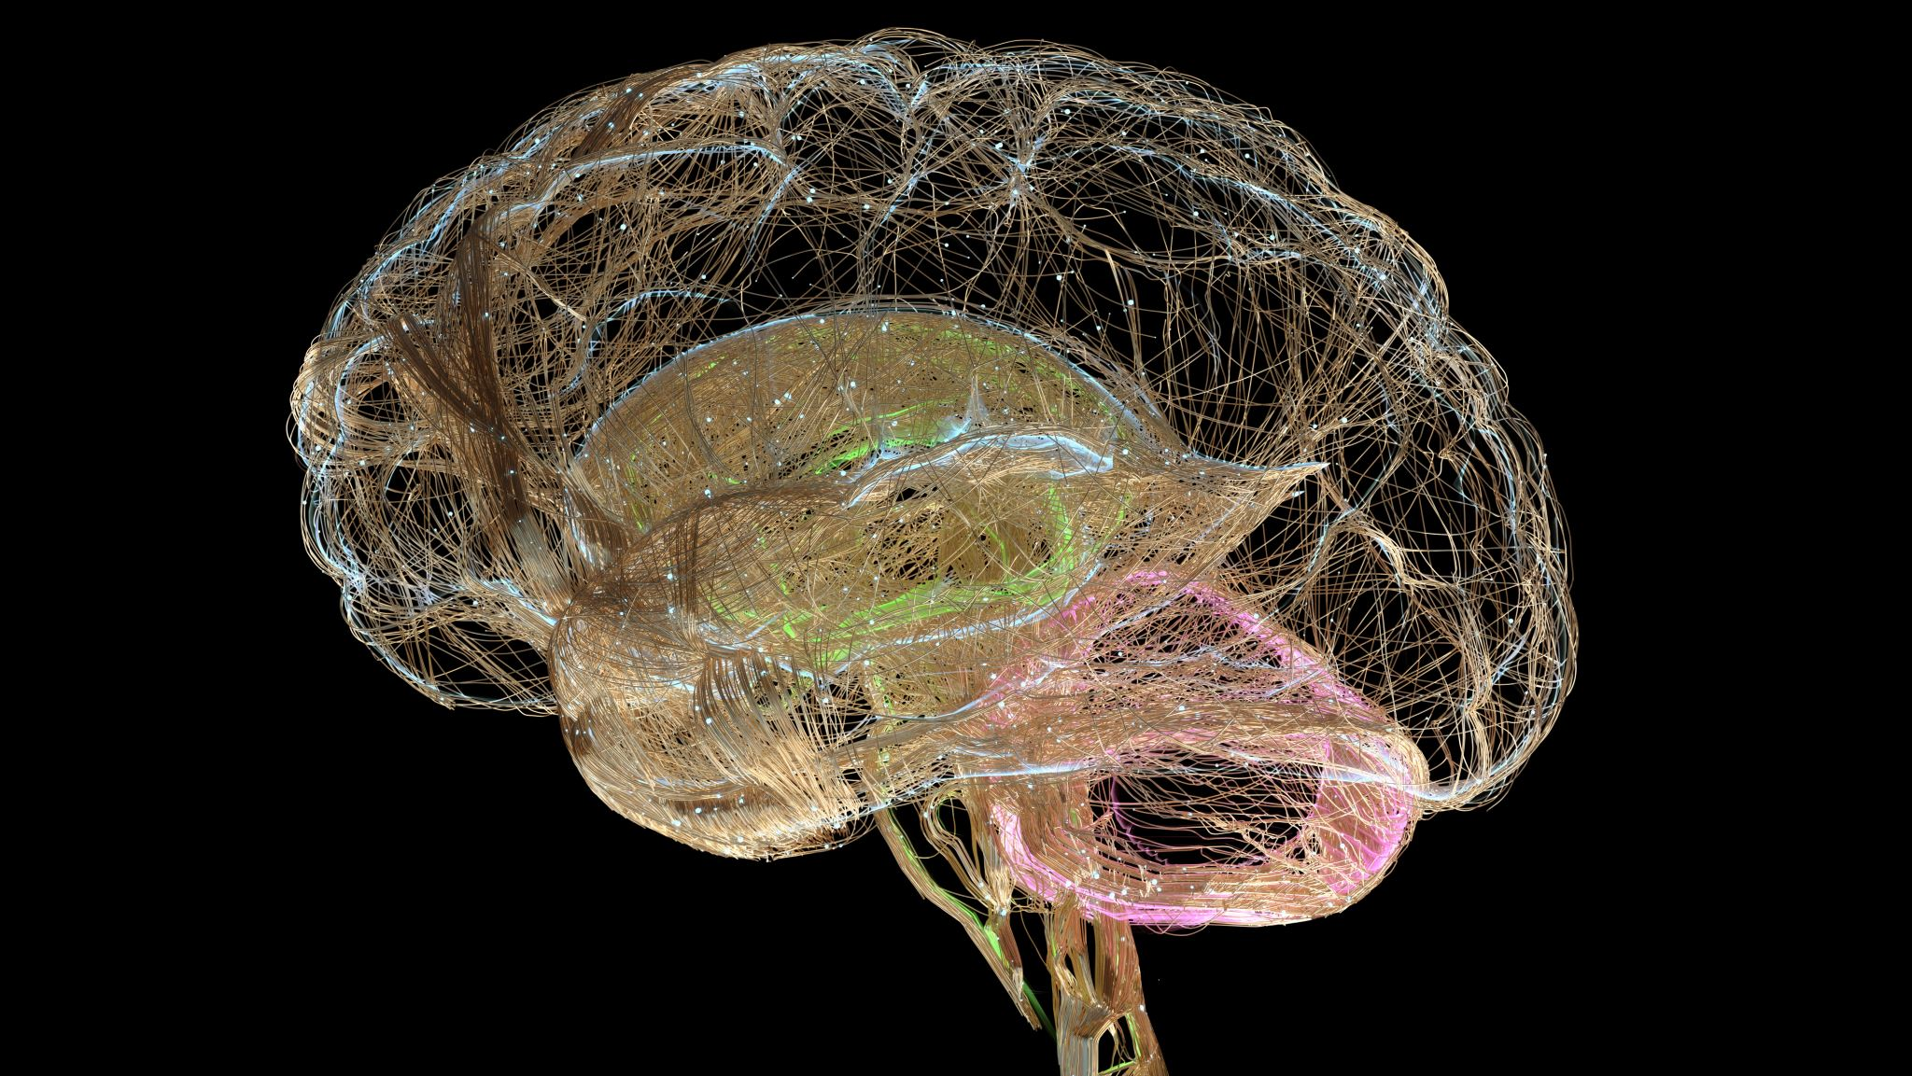
Unsupervised Learning and Predictive Modeling in Computational Neuroscience
FYS5429 Spring 2025
Oda Solesvik Oppedal

Slide 2

Background
Computational neuroscience leverages mathematical models and abstractions of the brain to understand the principles that govern neural behavior.
The goal is to further understand cognitive function, applications from pathology research (alzheimers) to improving AI and learning algorithms.

Slide 3
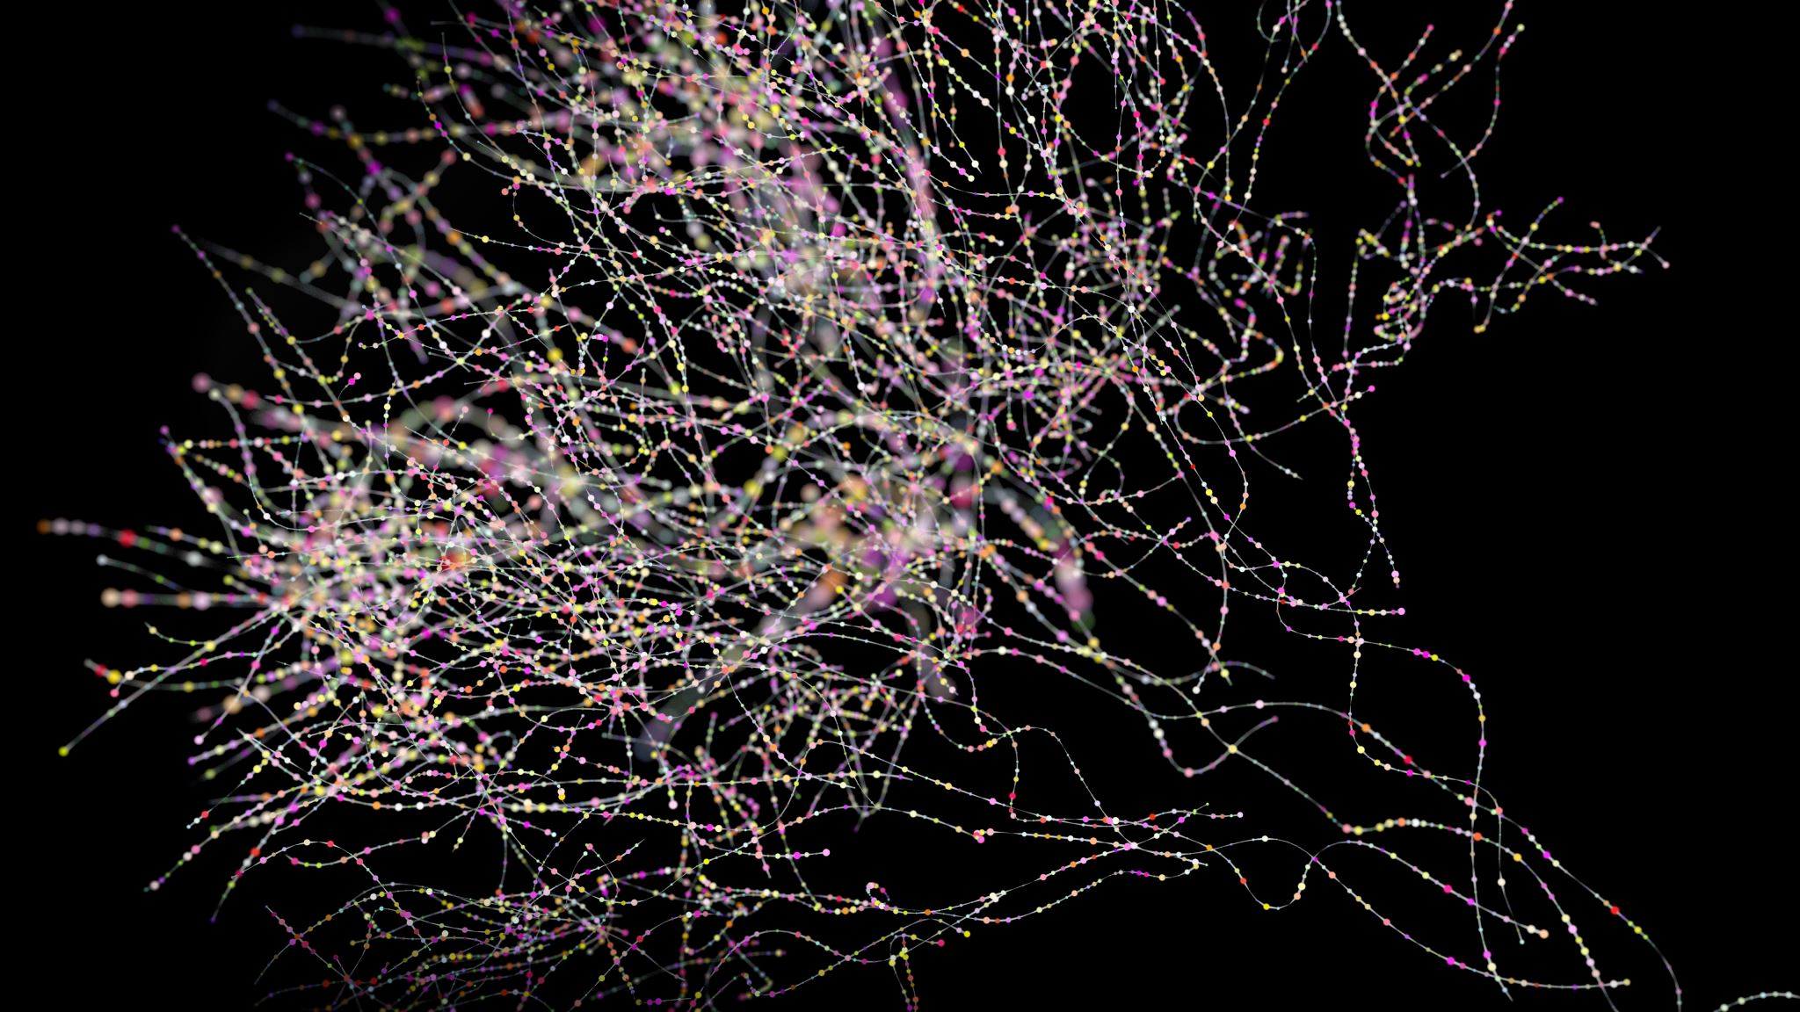
Background
Neurons produce action potentials, referred to as ‘spikes’. These are recorded using microelectrodes.
Spike sorting is a class of techniques used in the analysis of electrophysiological data. Algorithms use the shapes of waveforms collected from electrodes in the brain to distinguish the activity of one or more neurons from background noise.
Neuropixel probes are elecrodes that record the activity of hundreds of neurons in the brain.
Data includes cell type, cell position and spike shape. We have access to both simulated and experimental data from Gaute Einevoll’s research group.

Slide 4
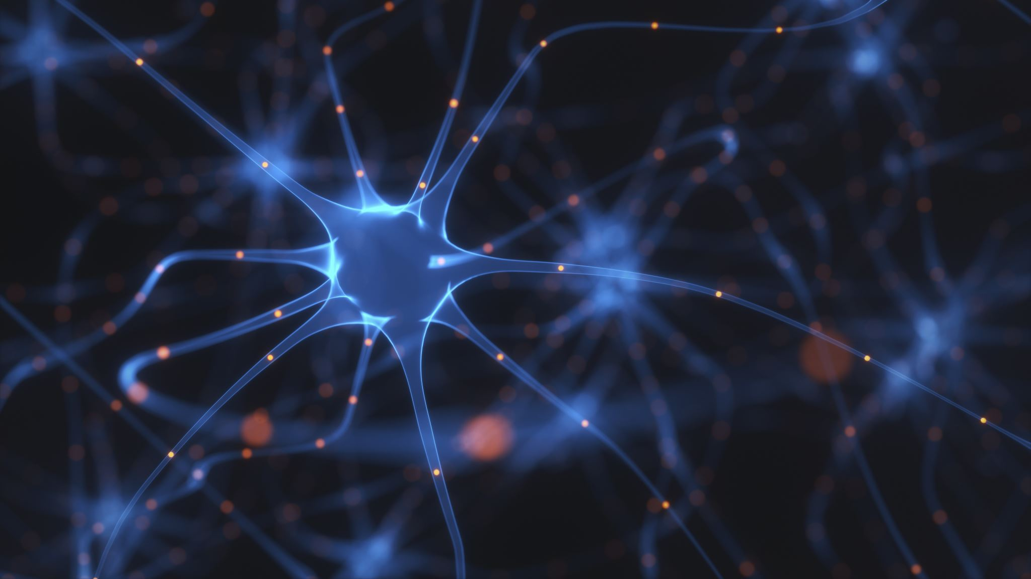
Project Objectives
Unsupervised Clustering: categorize neurons based on similarities in spike shapes. May hint at common functionalitites or connections within the brain.
Convolutional Neural Network (CNN): Train a CNN to predict cell type and position from spike shapes, exploring the network’s ability to capture spatial hierarchies in the data.
Autoencoder: Develop an autoencoder model that can efficiently compress and decompress spike shape data, potentially hihglighting intrinsic patterns.
Part 2 - Generative methods: Generative Adversarial Network (GAN), Variational Autoencoder (VAE), Diffusion models to predict spike shape from cell type and cell position.
Compare performance on simulated data vs. experimental data.

